Slide 1
Lecture 6
Method to Fulfill the Basic Human Aspirations

Slide 2


Slide 3
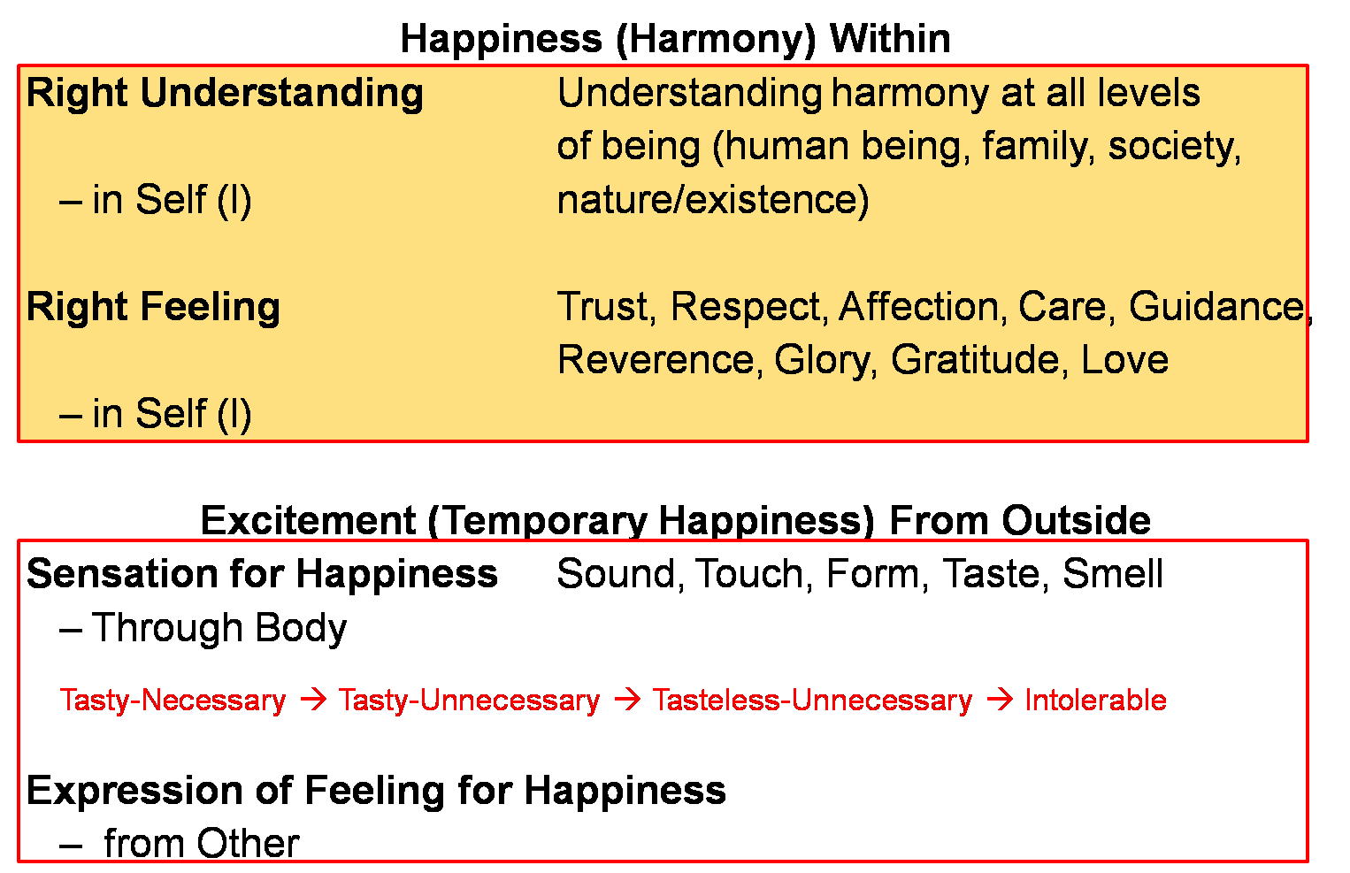


Slide 4
Human Being Living with Human Consciousness
RIGHT UNDERSTANDING
(le>)
in the self
Understanding Harmony
Understanding Harmony:
Harmony in Human Being
Harmony in Family
Harmony in Society
Harmony in Nature/Existence
Education –
Understanding
1
RELATIONSHIP (laca/k)
with human being
PHYSICAL FACILITY
(lqfo/kk)
with rest of nature
Living in Harmony
2
3
Living in Harmony
at all levels of being:
Individual
Family
Society
Nature/Existence
Sanskar – Living
MUTUAL HAPPINESS
(mHk; lq[k)
MUTUAL PROSPERITY
(mHk; le`f))

Slide 5
Happiness Continuity of Happiness
The state or situation, in which I live,
if there is harmony / synergy in it,
then it is Naturally Acceptable to me to be in that state / situation
(and I want to continue to be in that state / situation)
To be in a state / situation which is Naturally Acceptable is Happiness
To be in a state of Harmony / Synergy is Happiness
Happiness = To be in Harmony
State / Situation in which I live
or expanse of my being:
  As an Individual Human Being
  As a member of a Family
  As a member of Society
  As an unit in Nature/Existence
Continuity of Happiness
= Harmony at all levels of being i.e.
  Harmony in the Human Being
  Harmony in the Family
  Harmony in the Society
  Harmony in Nature/Existence

Slide 6
Our Program
To facilitate understanding of the harmony at all levels of being
  Harmony in the Human Being
  Harmony in the Family
  Harmony in the Society
  Harmony in Nature/Existence
To understand harmony and to live in harmony at all levels of being
  In the Human Being
  In the Family
  In the Society
  In Nature/Existence
Proposals
1
Verify the proposals
on the basis of your NATURAL ACCEPTANCE
b) Experiential validation
by LIVING ACCORDINGLY
2
Right Understanding
Right Feeling

Slide 7

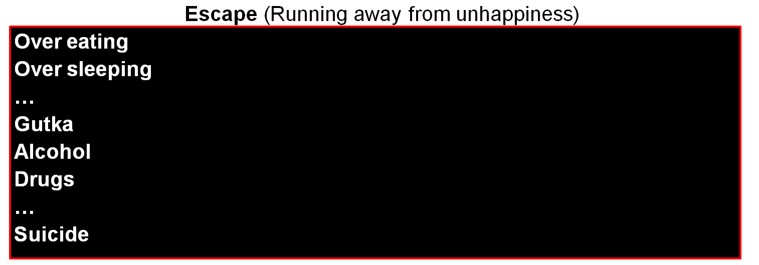
Continuous happiness
Realised
(Dorji)
Human Consciousness
--------------------------------------------------------------------- Transformation / Development -----------------------------------------
Temporary excitement
Recovering
Addict
Animal Consciousness
Temporary escape from unhappiness
Addict

Slide 8
Practice Session after Lecture 6
Observe that you have the faculty of ‘Natural Acceptance’, based on which you can verify what is right or what is not right for you. Of course, you may or may not be generally referring to your natural acceptance for making decisions. So, find out if you get a spontaneous answer when you ask yourself basic questions, like the ones mentioned below:
  You want to live in relationship (harmony) with others or You want to live in opposition with others?
  In relationship, you want to live with the feeling of respect or disrespect (for yourself and for others)?
  You want to nurture others or to exploit others?
Is your living in accordance with your natural acceptance or different from it? How do you feel when your living is in accordance with your natural acceptance; and when it is in contradiction to your natural acceptance?
Make a list of the problems in your family. For each problem, find out the most significant reason: is it related to lack of right understanding, lack of feelings in relationship or lack of physical facility? Also find out how much time and effort you have devoted for each in the last one week.

Slide 9
Expected Outcome
The students are able to see that self-verification on the basis of their natural acceptance (and experiential validation through living) is an effective way to verify what is right and what is wrong for them.
They are able to see that, in many cases, their actual living is not in accordance with their natural acceptance.
They are able to see that they are uncomfortable when their living is in contradiction with their natural acceptance; they are comfortable when they are living in accordance with their natural acceptance.

Slide 10
FAQs for Lecture 6
Method to Fulfill the Basic Human Aspirations

Slide 11
Questions
If ensuring harmony at one level disturbs the harmony at some other level, how can I make the program for continuity of happiness?
e.g. taking care of my baby and doing justice with my job
e.g. when I invest myself for right understanding, the family members feel angry on me, and there is disharmony in the family.
Few people in the history have said that the biggest hurdle in the development of society is family. They propounded the concept of commune. Where do we place the commune here?
If there is disharmony in the society, I will also be in disharmony as I am part of society. Then how can I ensure happiness in continuity? Similar with nature.
...

Slide 12
Self Reflection

Slide 13
Question(s) 1: Four Levels Response
If ensuring harmony at one level disturbs the harmony at some other level, how can I make the program for continuity of happiness?
e.g. taking care of my baby and doing justice with my job
e.g. when I invest myself for right understanding, the family members feel angry on me, and there is disharmony in the family.
Few people in the history have said that the biggest hurdle in the development of society is family. They propounded the concept of commune. Where do we place the commune here?

Slide 14
Question(s) 2: Four Levels Response
If there is disharmony in the society, I will also be in disharmony as I am part of society. Then how can I ensure happiness in continuity? Similar with nature.
How do I demarcate between family and society? e.g. my in-laws, extended family members, neighbors, friends, etc.
I have a pet, and I treat it like a family member. Is it fine to do it as it is not a human being?

Slide 15
Question(s) 2: Four Levels Response
Where do I put my organization or place of work here? In family or society?
Why have we put nature and existence together at the fourth level?
How can I be in harmony with the entire nature/existence? I don’t even know so many things in the nature/existence.

